Slide 1
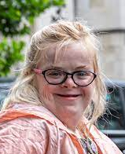
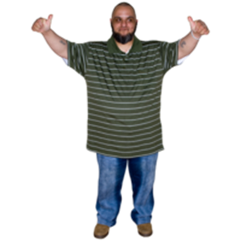
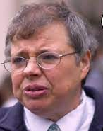

Downright Discrimination Court Case
13th July 2022
:
Heidi Crowter has Down syndrome.
.
Heidi wants the law to say that everyone has the same right to be born and have a good life.
If you agree with Heidi please support her at the High Court.
If you want to help you can contact Simone Aspis Support Worker at simone.pers.ass@gmail.com
For more information click www.rofa.org.uk

